Slide 1
CERT Basic Training
Unit 5: Disaster Psychology

Slide 2
Unit 5 Objectives
Understand disaster trauma for survivors and rescuers, including CERT volunteers
List steps to take for personal and team well-being
Demonstrate key steps to apply when providing aid to someone with survivor’s trauma
PM 5-1
CERT Basic Training Unit 5: Disaster Psychology
5-1

Slide 3
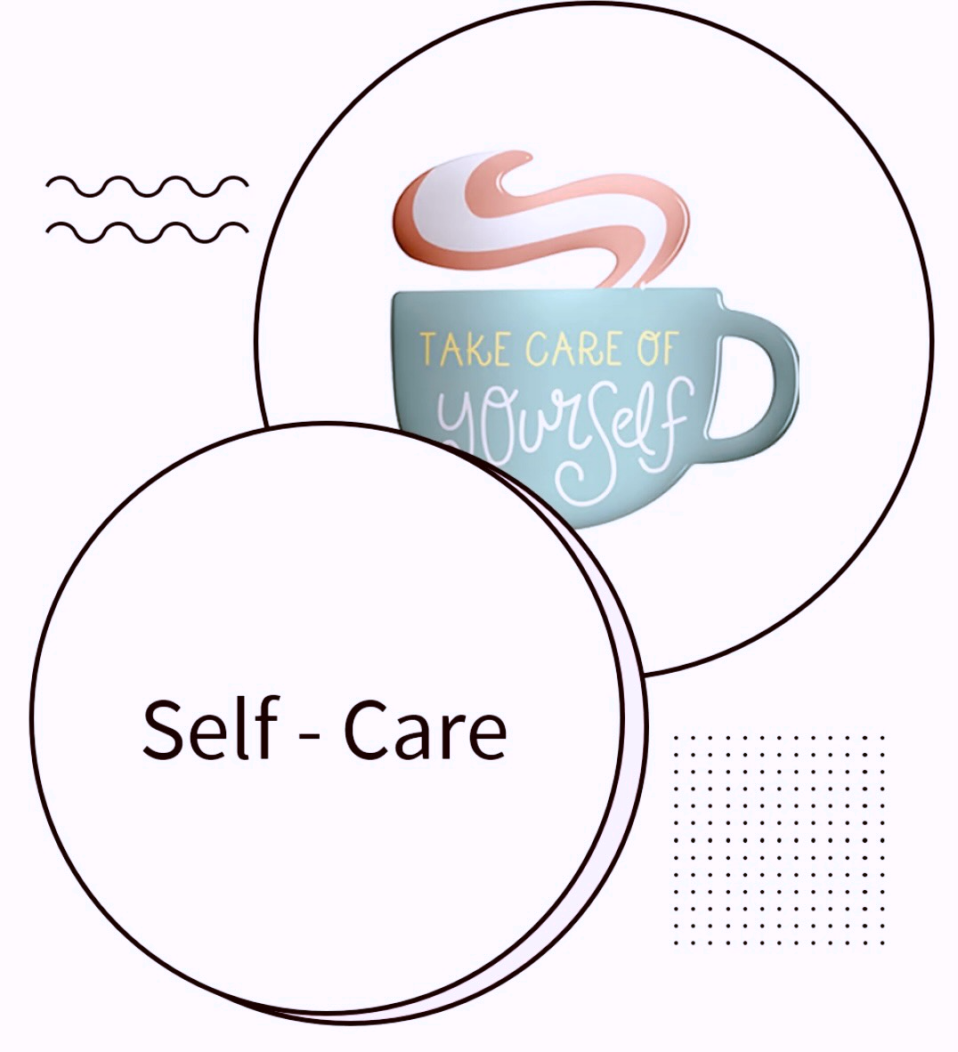
Self-care
We all have different life experiences. Discussing disasters and emergency response will affect each of us differently
Acknowledge your feelings
Breathe
Take breaks if needed
CERT Basic Training Unit 1: Disaster Preparedness
1-2
Notes:
We will review Unit 1 Disaster Preparedness and Unit 2 CERT Organization today

Slide 4
Causes of Disaster Reactions
Dealing with your own personal losses
Working in your neighborhood
Assisting neighbors, friends, or coworkers who have also been injured
Feeling unsafe and insecure
PM 5-2
CERT Basic Training Unit 5: Disaster Psychology
5-2

Slide 5

Expectations?
Living conditions will be different
Normal routines will be uprooted

Slide 6
How Stress is Handled – the Lizard Brain
Freeze: “Stop, look, and listen,” or be on guard and watchful
Flight: Flee
Fight: Attempt to combat the threat
Fright: Tonic immobility when in
contact with a predator, or playing dead
Faint: Fear-induced fainting
PM 5-2
CERT Basic Training Unit 5: Disaster Psychology
5-3
Notes:
Focused on survival: Fight, flight, freeze, sex, food. Events may trigger memories of emotional events and our deepest fears

Slide 7
Psychological Symptoms of Trauma
Emotional
  Irritability or anger
Cognitive
  Lack of focus
Spiritual
  Loss of hope
GRAPHICWITHART VIA GETTY IMAGES
PM 5-2
CERT Basic Training Unit 5: Disaster Psychology
5-4
Notes:
Discuss other emotional, cognitive, Emotional – nervousness, numb, inability to feel love, agitation, denial, feeling of being overwhelmed. Cognitive – difficulty making decisions, disturbing dreams, memories & flashbacks, distortion of time & space, repeatedly replaying the event. Spiritual – questioning (why me? ), intense prayer

Slide 8
Physical Symptoms of Trauma
Loss of appetite
Headaches or chest pain
Diarrhea, stomach pain, or nausea
Hyperactivity
Increase in drug consumption
Nightmares
Insomnia
Fatigue
PM 5-3
CERT Basic Training Unit 5: Disaster Psychology
5-5

Slide 9
Take Care of Yourself
Be aware of trauma that can follow a disaster
Explain to family members and friends what you need:
  Let them know when you want to talk
  Don’t force yourself to talk until you are ready
PM 5-4
CERT Basic Training Unit 5: Disaster Psychology
5-8

Slide 10
How to Reduce Stress
Get enough sleep
Exercise regularly
Eat a balanced diet
Balance work, play, and rest
Allow yourself to receive as well as give
Connect with others
Use spiritual resources
NPS photo
PM 5-4
CERT Basic Training Unit 5: Disaster Psychology
5-7

Slide 11
Self-Care Tool Box Discussion
This activity provides you with the opportunity to discuss a number of self-care tools you used during the recent COVID-19 crisis.
Break into small groups. When everyone has finished, your group will have the opportunity to share your responses. Pick a spokesperson to share your findings.
PM 5-5
CERT Basic Training Unit 5: Disaster Psychology
5-9
Notes:
Maybe use graphics for the topics to possible consider

Slide 12
Six Emotional Phases of a Crisis
Pre-Disaster
Impact
Heroic
Honeymoon
Disillusionment
Reconstruction
PM 5-8
CERT Basic Training Unit 5: Disaster Psychology
5-11

Slide 13
Traumatic Crisis
A traumatic crisis is an event experienced or witnessed in which people’s ability to cope is overwhelmed by:
  Actual or potential death or injury to self or others
  Serious injury
  Destruction of their homes, neighborhood, or value possessions
  Loss of contact with family or close friends
PM 5-9
CERT Basic Training Unit 5: Disaster Psychology
5-12
Notes:
George Floyd’s brother visits the site of George Floyd’s death

Slide 14
Effects of Traumatic Stress
Traumatic stress may affect:
  Cognitive functioning
  Physical health
  Interpersonal relationships
PM 5-9
CERT Basic Training Unit 5: Disaster Psychology
5-13

Slide 15
Mediating Factors
Prior experience with a similar event
Intensity of disruption
Individual feelings about event
Emotional strength of individual
Length of time since event
PM 5-9
CERT Basic Training Unit 5: Disaster Psychology
5-14

Slide 16
Exercises
Victim
Rescuer

Slide 17
Stabilizing Survivors
Assess survivors for injury or shock
Get uninjured people to help
Provide support by listening and empathizing
Help survivors connect with natural support systems
PM 5-10
CERT Basic Training Unit 5: Disaster Psychology
5-15

Slide 18
Listen, Protect, Connect
Listen to survivors and pay attention to what they say
Help survivors feel protected by providing support
Connect survivors to friends and loved ones
PM 5-10
CERT Basic Training Unit 5: Disaster Psychology
5-16

Slide 19
How to Be an Empathetic Listener
Put yourself in the speaker’s shoes
Listen for meaning, not just words
Pay attention to nonverbal communication
Paraphrase the speaker
PM 5-11
CERT Basic Training Unit 5: Disaster Psychology
5-17

Slide 20
What Not to Say
“I understand ”
“Don’t feel bad ”
“You’re strong ”
“You’ll get through this ”
“Don’t cry ”
“It’s God’s will ”
“It could be worse ”
“At least you still have…”
“Everything will be okay”
PM 5-12
CERT Basic Training Unit 5: Disaster Psychology
5-18

Slide 21
Say This Instead
“I’m sorry for your pain ”
“I’m so sorry this has happened ”
“Is it all right if I help you with…?”
“I can’t imagine what this is like for you ”
“What do you need?”
PM 5-12
CERT Basic Training Unit 5: Disaster Psychology
5-19

Slide 22
Team Well-Being
Actions can be taken before, during, and after an incident to help manage emotional impact of disaster response work
Knowing possible psychological and physiological symptoms of disaster trauma helps manage impact
Learn to manage stress:
  CERT volunteers for themselves
  CERT leaders during response
PM 5-4
CERT Basic Training Unit 5: Disaster Psychology
5-6

Slide 23
How Team Leaders Reduce Stress
Brief CERT personnel beforehand
Remember CERT is a team
Rest and regroup
Take breaks away from the incident site
Establish a culture of acceptance
Eat properly, stay hydrated
Be aware of changes in teammates
Rotate teams and duties
Phase out workers gradually
Defuse after shift
PM 5-7
CERT Basic Training Unit 5: Disaster Psychology
5-10

Slide 24
Managing the Death Scene
Cover the body; treat it with respect
Follow local laws and protocols
Talk with local authorities
PM 5-12
CERT Basic Training Unit 5: Disaster Psychology
5-20

Slide 25
Unit Summary (Unit 5)
Prepare yourself, as rescues may be unpleasant and uncomfortable
Know the psychological and physiological symptoms of trauma
Understand the six emotional phases of a disaster
Take steps to reduce stress, which affects cognition, health, and interactions
Stabilize individuals
Listen, protect, and connect to support survivors
Be an empathetic listener
PM 5-13
CERT Basic Training Unit 5: Disaster Psychology
5-21

Slide 26

Break(Unit 5)
Return at
_______
After Break:
Disaster Medicine
Part 2
CERT Basic Training Unit 5: Disaster Psychology
5-22

